Slide 1
Family House Hunters – Raleigh, NC

Slide 2
Agenda
Business Problem
Data Acquisition & Cleaning
Identifying Top Ranked City for Families
Identifying Correlation between Student Teacher Ratio & School Scores
Conclusion

Slide 3
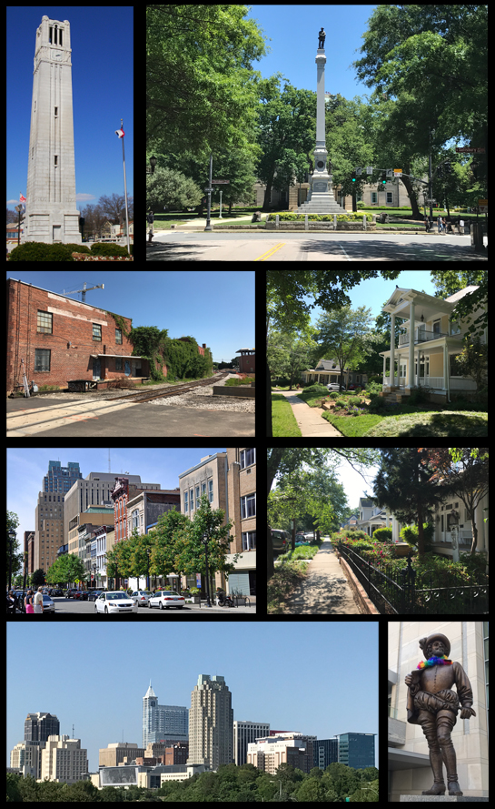
Business Problem
Raleigh is the capital of the state of North Carolina and seat of Wake County in the United States. It is one of the most popular destinations for families in the state of North Carolina.
The task at hand is to find the ideal neighborhood in the Wake County for a family with kids.
The ideal neighborhood will have easy access to schools, parks and shopping malls.
In addition, we also want to see if there is a correlation between Student Teacher Ratio and School’s Reading/Math score

Slide 4
Data Acquisition & Cleaning
Name | Source | Purpose
Schools | National Center for Educational Statistics (link) NC Department of Public Instruction (link) | We will use two datasets from these sources to come up with the list of best schools available in a given City or Township. The first dataset from NCES provides the listing of public schools within Wake County, along with Student-Teacher ratio for each school. The second dataset from DPI provides the School Performance Grade in the areas of Math and Reading. We will use these 3 parameters to assess the neighborhood's schools.
Parks | Four Square API | Using Four Square API, we can get a listing of all Parks available within Wake County. This dataset includes user rating which we will use as part of our scoring.
Shopping Malls | Four Square API | Using Four Square API, we can get a listing of all Shopping Malls available within Wake County. This dataset includes user rating which we will use as part of our scoring.

Slide 5
Data Acquisition & Cleaning
Any school that did not have a Student Teacher Ratio or Reading/Math scores were dropped from this exercise
Parks & Shopping malls where no User Rating was available from Four Square were also dropped
The City field in Schools dataset had some typos that were corrected. For example, both “Fuquay Varina” and “Fuquay-Varina” refer to the same city so the extra punctuations were removed

Slide 6
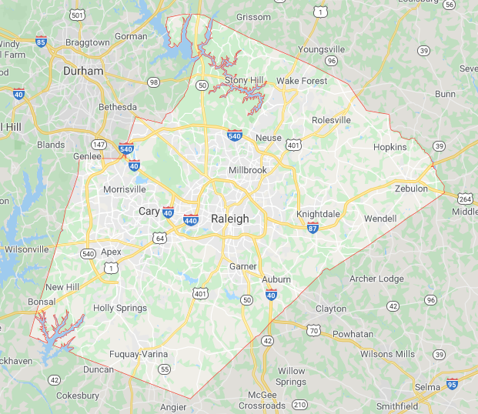
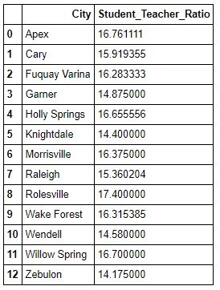
Identifying top ranked cities for Families
Based on data from National Center for Educational Statistics, average Student Teacher Ratio for each city is calculated for all schools in Wake County, NC

Slide 7
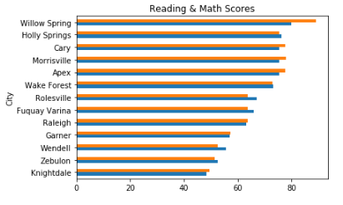
Identifying top ranked cities for Families
Another dataset from the Department of Public Instruction was used to get the Reading & Math scores across all schools

Slide 8
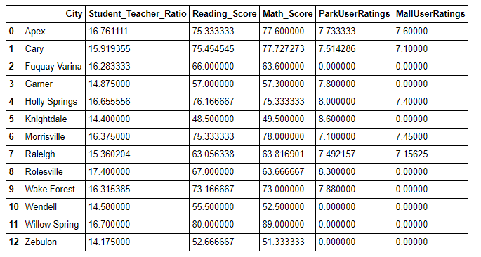
Identifying top ranked cities for Families
Using Four Square APIs, the listing of parks and shopping malls along with respective user ratings were obtained for each city in Wake County

Slide 9
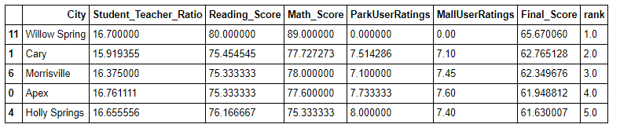
Identifying top ranked cities for Families
Using a ranking algorithm based on weightage given to Student Teacher Ratio, Reading/Math scores, Park ratings & Shopping Mall ratings, the top 5 cities were identified

Slide 10
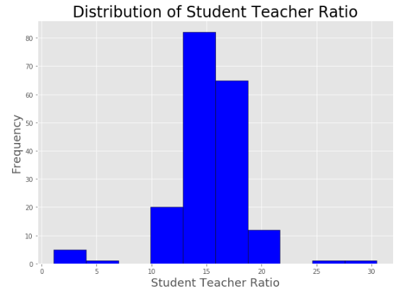
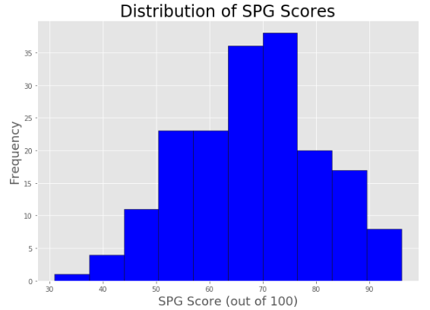
Identifying Correlation between Student Teacher Ratio & School Scores
We use linear regression to model the relationship between dependent variable (School Scores) and independent variable (Student Teacher Ratio)
To better understand the distribution of these variables, we plot a histogram that indicates a Normal Distribution

Slide 11
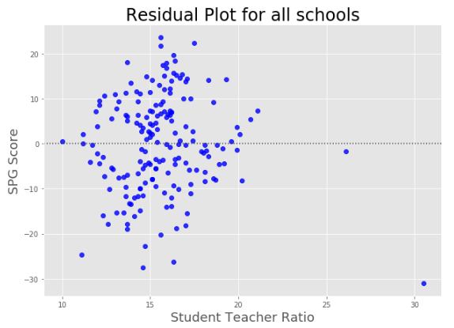
Identifying Correlation between Student Teacher Ratio & School Scores
Residual Plot is used to confirm if linear regression can be used for the 2 variables
As we can see, the points are randomly distributed around 0, meaning linear regression is an appropriate model to predict our data

Slide 12
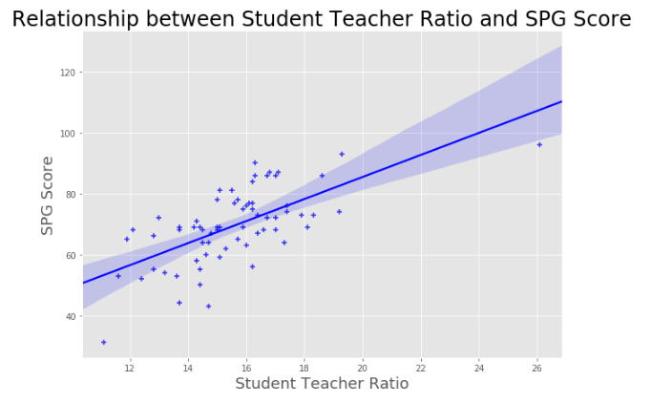
Identifying Correlation between Student Teacher Ratio & School Scores
Using Seaborn library, we have a regression plot that shows a positive correlation between Student Teacher Ratio & School Scores of 0.654

Slide 13
Conclusion
Using data from multiple sources (NCES, DPI), along with exploratory analysis using Four Square API, we conclude that Willow Springs is the best city for families:
Even though there are no parks or malls in Willow Spring, it came out at the top spot as more weightage has been given to School Ratings (85%) rather than other amenities.
Holly Springs has 2nd highest Reading & Math scores, but due to a comparatively high Student to Teacher Ratio, it got a lower ranking than Cary, Morrisville & Apex
Between Apex and Morrisville, even though both have equally good Reading & Math scores and Shopping malls, Apex lost out due to higher Student-Teacher ratio.

Slide 14
Conclusion
As schools are an important criteria to identify the ideal neighborhood, we also validated whether there is any correlation between Student Teacher Ratio and Total SPG Score. The results from this was surprising.
Common understanding is that lower Student Teacher Ratio means Teachers would pay more attention to a smaller class size and result in a higher student performance.
But since there is a positive correlation between Student Teacher Ratio and Total SPG Score, this common understanding doesn't hold true for schools in Wake County.
So there could be other attributes that may have an impact to Total SPG Score such as ethnicity, gender or teaching quality which would be worth exploring further

Slide 15
Thank You

